Slide 1
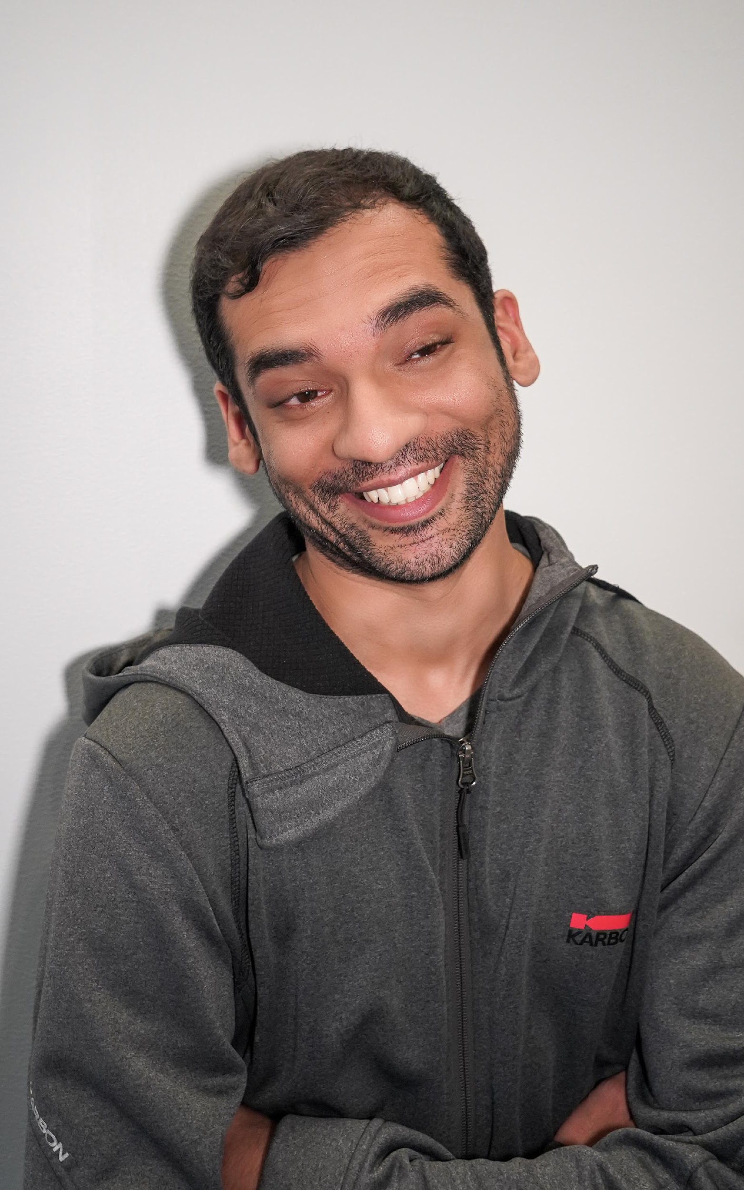
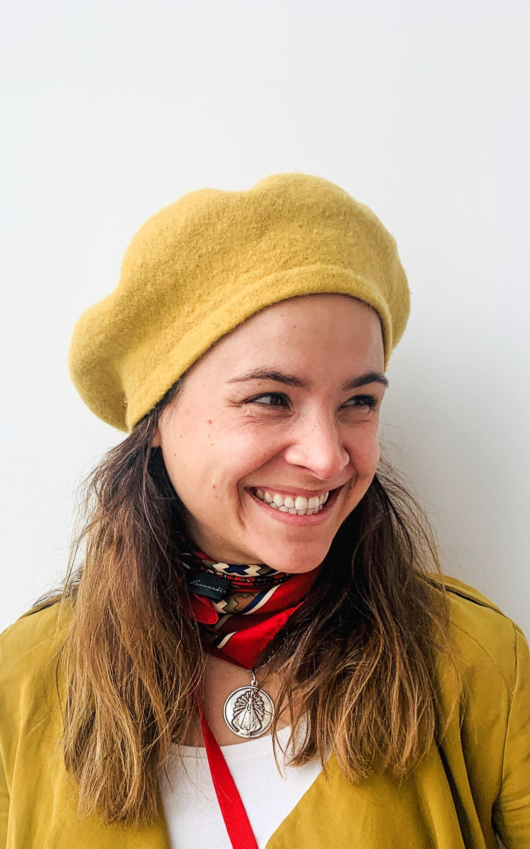
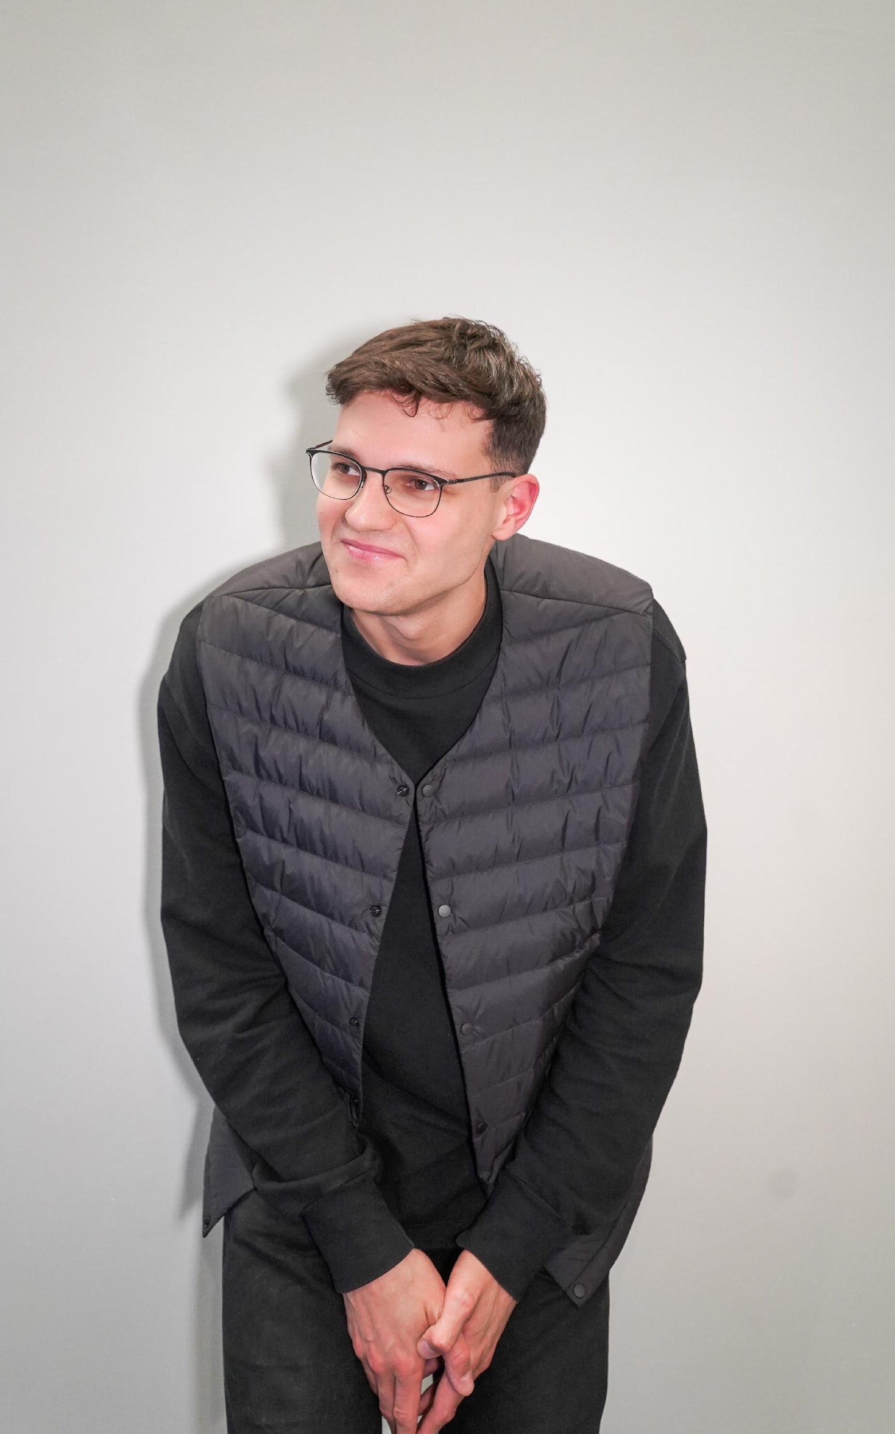
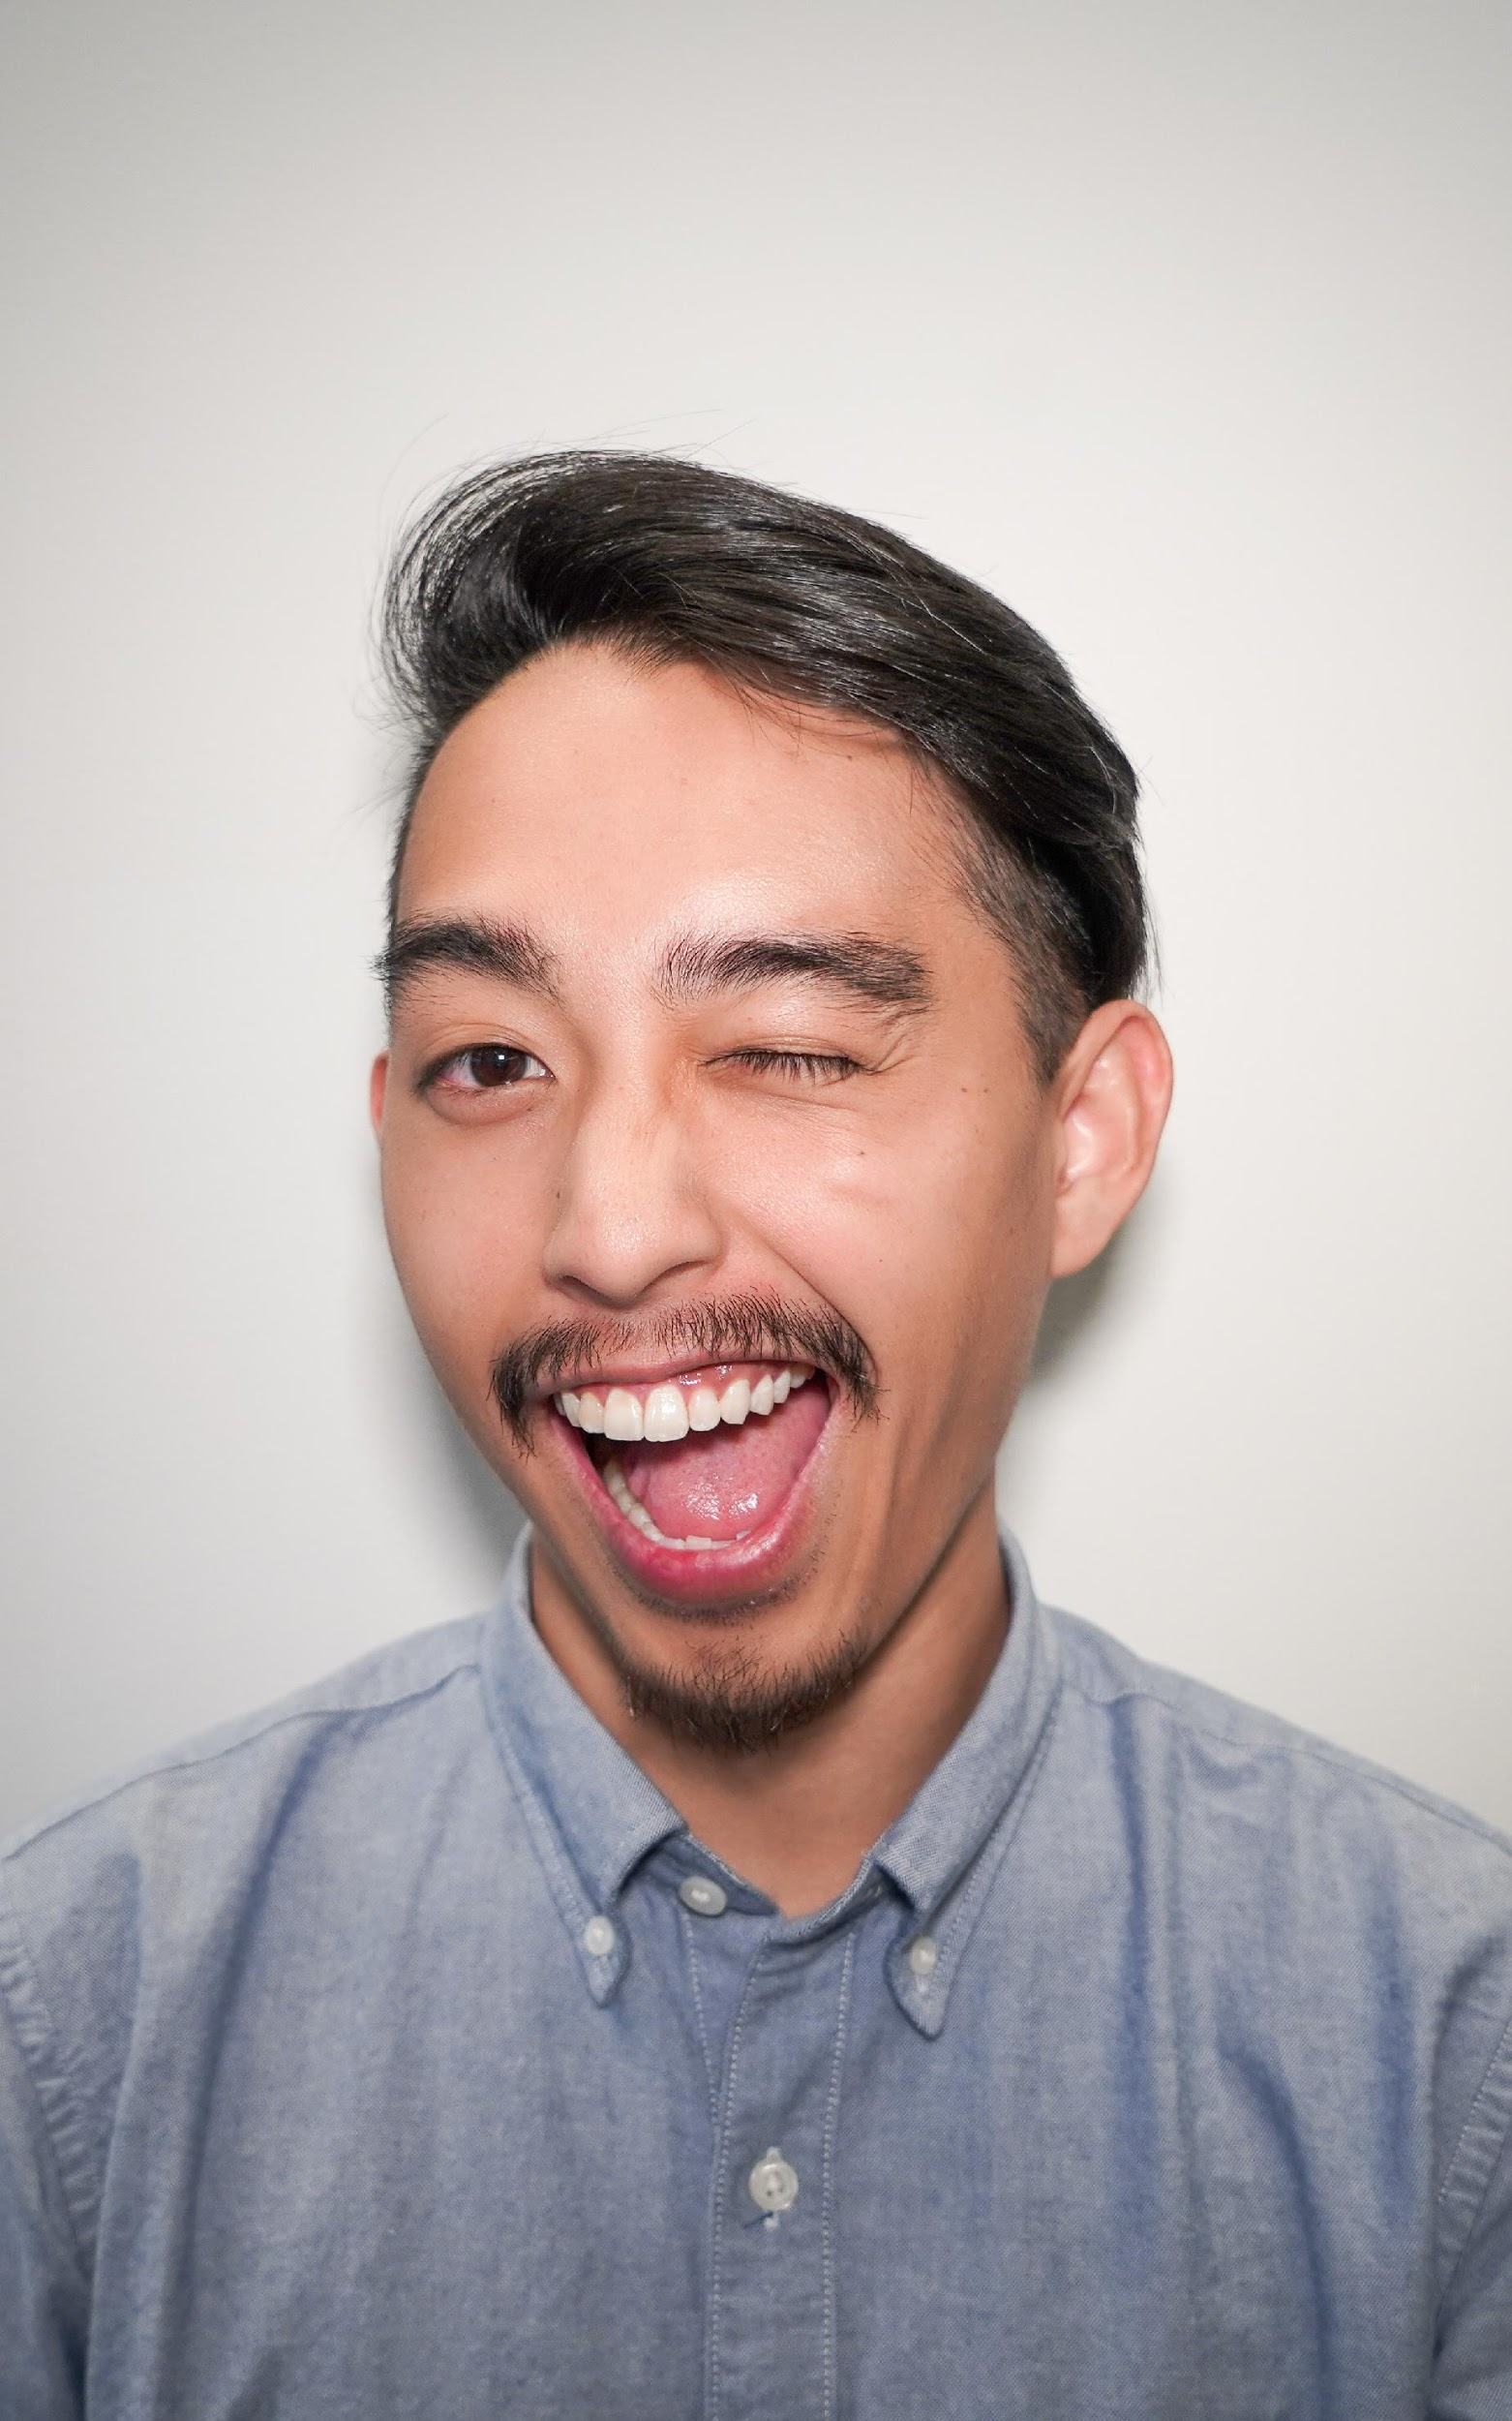
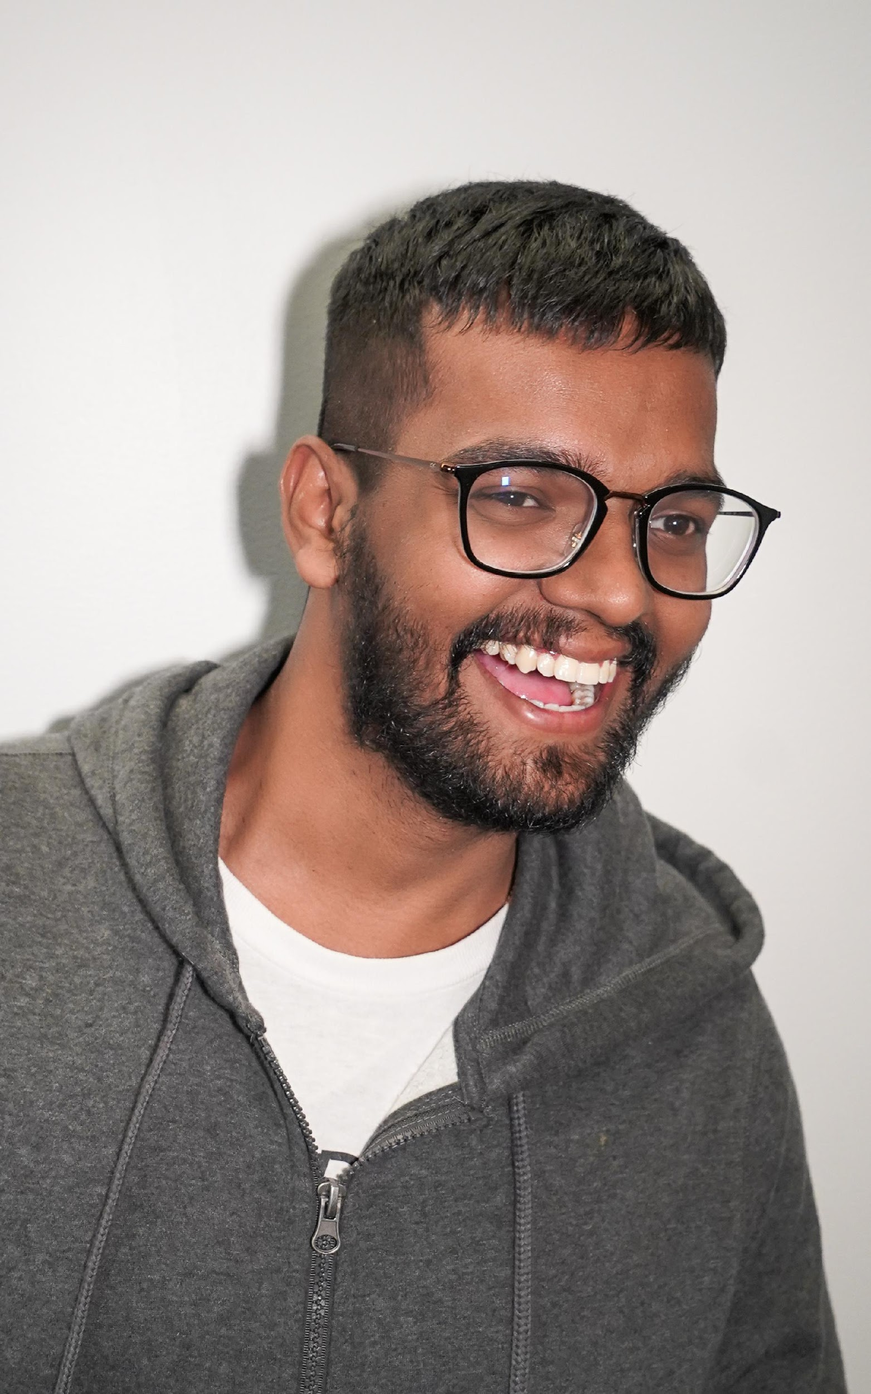
Hunaid
MBA
Mechi
LLM
Max
Design
Willy
ORIE
Omesh
CM
#thirtynine

Slide 2
How might we improve the lives of gig workers so that they are financially healthy and more resilient to financial shocks?
Bill & Melinda Gates Foundation

Slide 3


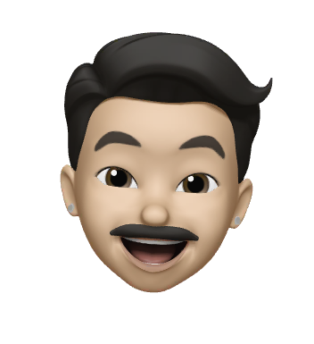
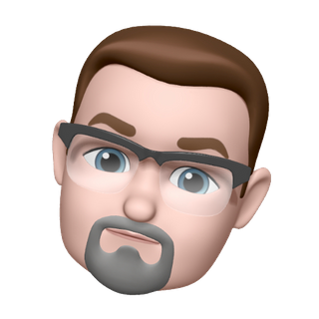
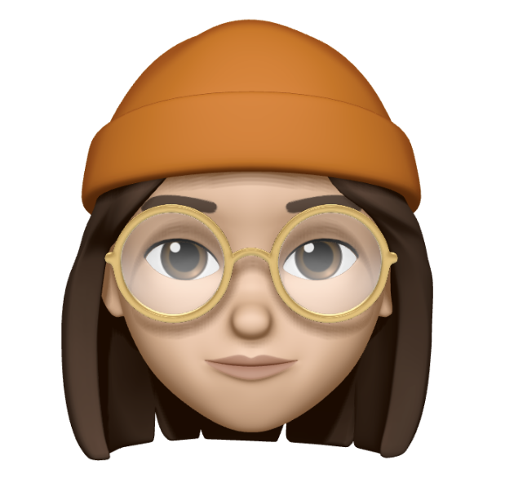
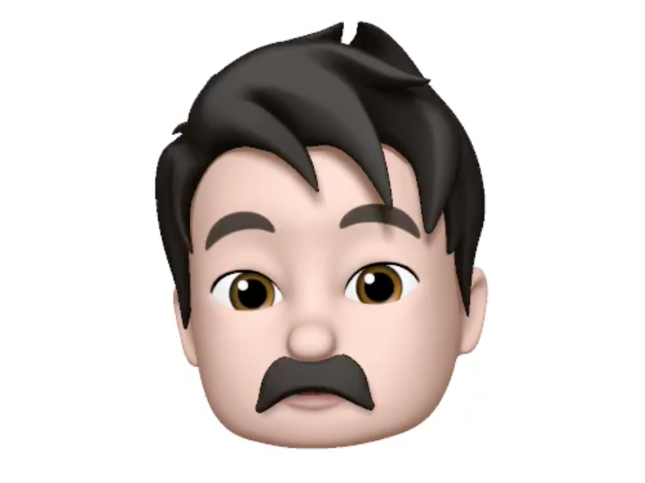
"We are having incredibly long work hours, due to a significant amount of downtime"
Notes:
Our research shows us that gig workers are facing one major issue throughout industries
That is the amount of downtime in their everyday work life
Example: An Uber driver we have interviewed told us, that he usually has to spend up to 17 hours in the car to get 10 hours of work done
That is a problem but also an opportunity
We are suggesting a digital tool enabling gig workers to manage their work time more efficiently

Slide 4



Slide 5

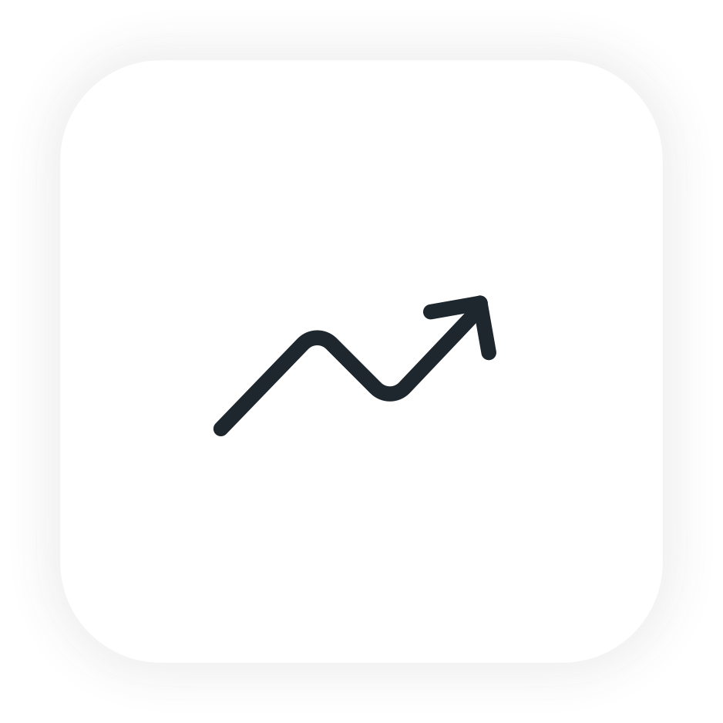

Slide 7



Experiment 1
Email Parser
Experiment 2
Prototyping
Experiment 3
Tag/Text Along

Slide 8
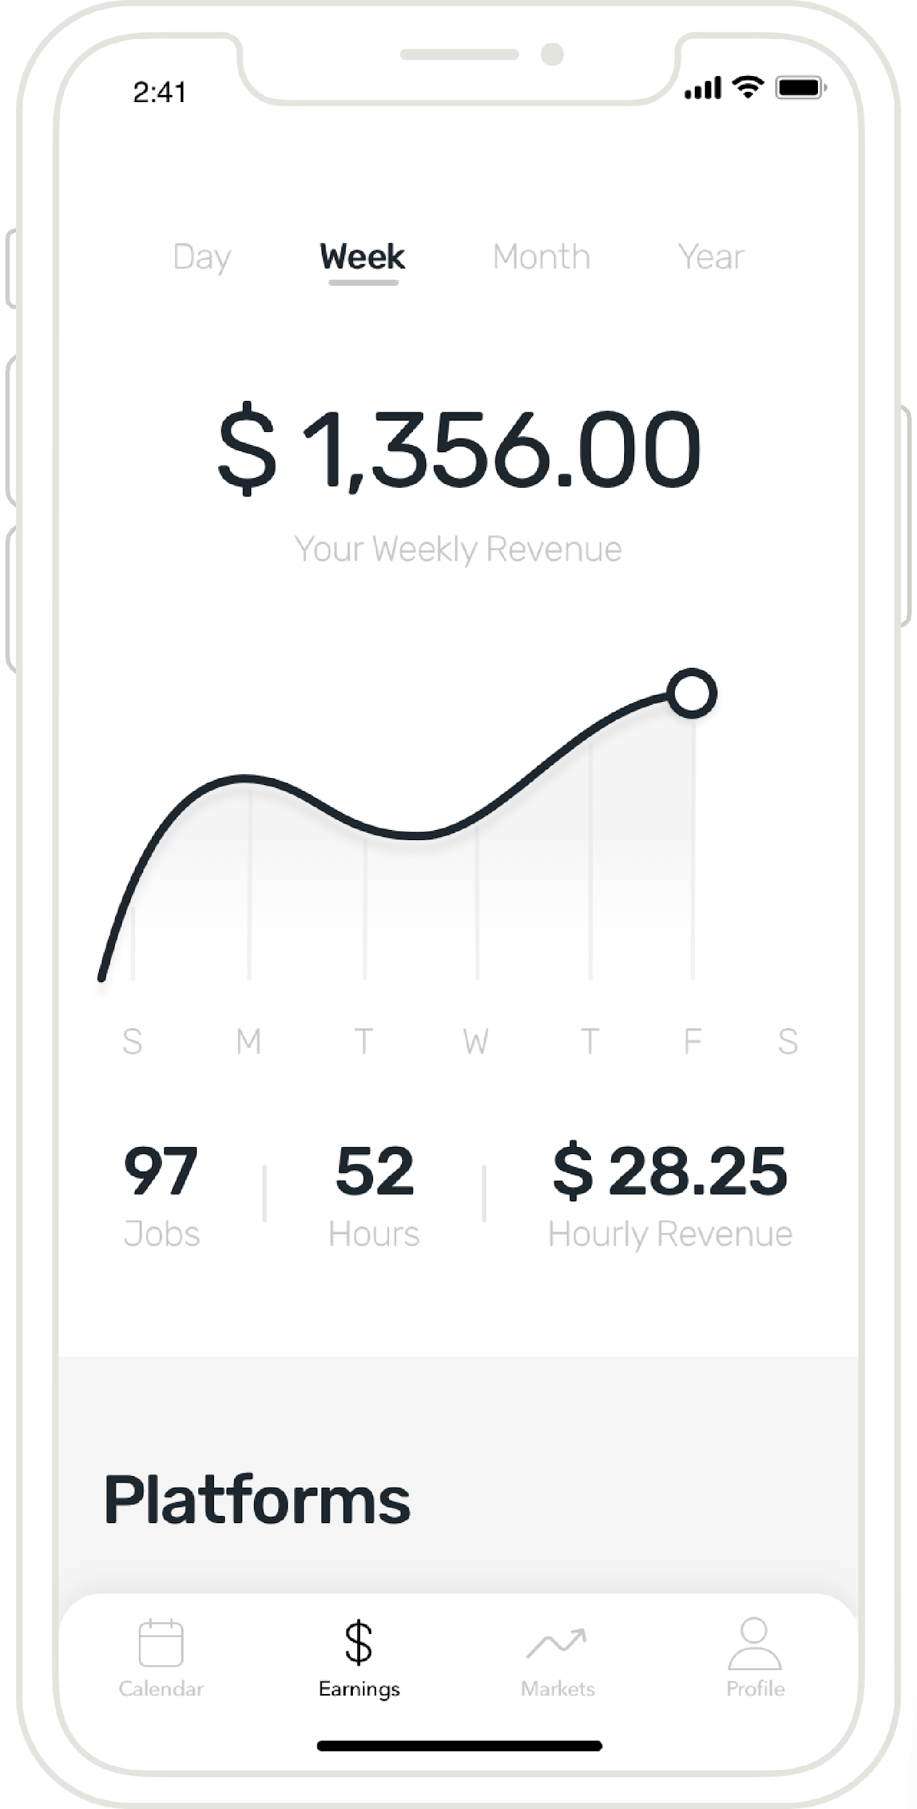
Notes:
User driven dashboard App for Gig Workers
GW can see which platform is most profitable at a certain point of time and at a specific location
Our goal is to provide..
Gig workers with a dynamic and transparent mobile platform that enables them to monitor their markets, make smarter decisions and ultimately

Slide 9
Tech
Placeholder
Notes:
User driven dashboard App for Gig Workers
GW can see which platform is most profitable at a certain point of time and at a specific location
Our goal is to provide..
Gig workers with a dynamic and transparent mobile platform that enables them to monitor their markets, make smarter decisions and ultimately

Slide 10
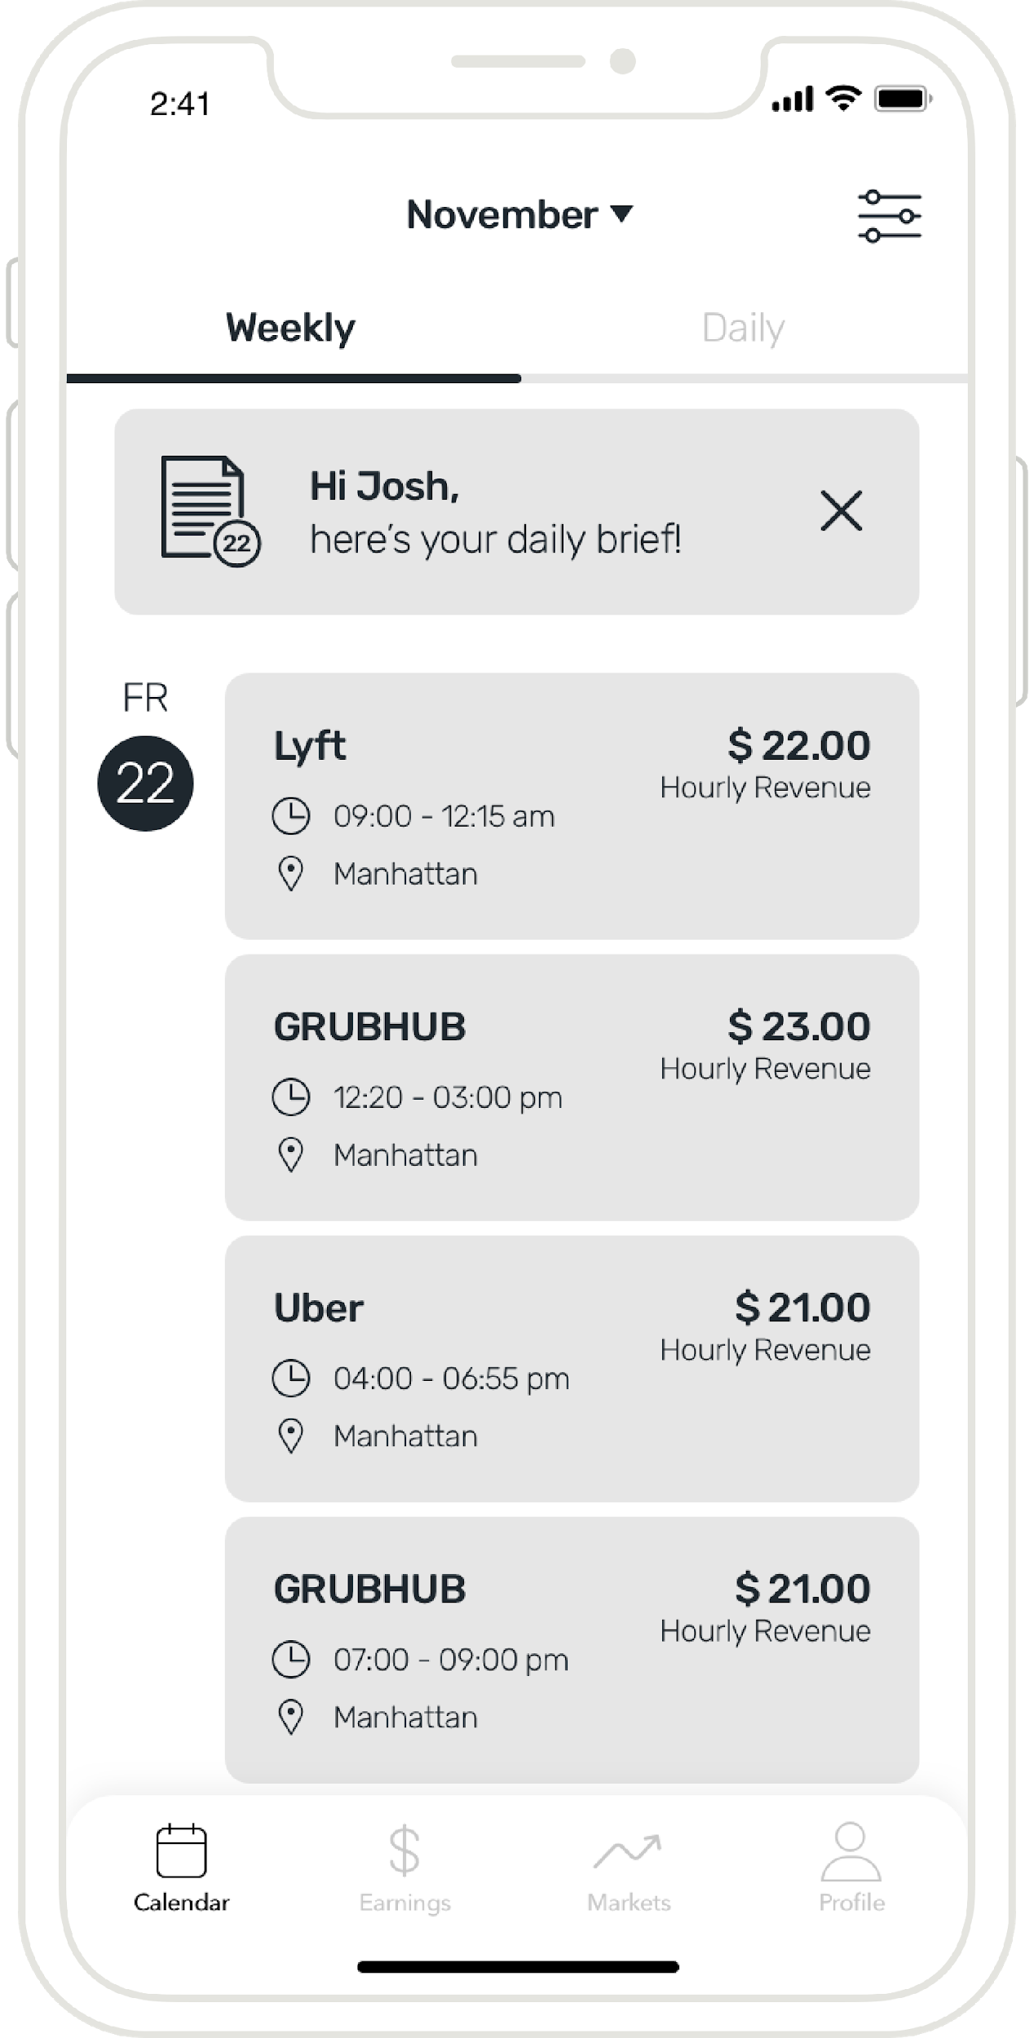
Notes:
User driven dashboard App for Gig Workers
GW can see which platform is most profitable at a certain point of time and at a specific location
Our goal is to provide..
Gig workers with a dynamic and transparent mobile platform that enables them to monitor their markets, make smarter decisions and ultimately

Slide 11
Tech
Placeholder
Notes:
User driven dashboard App for Gig Workers
GW can see which platform is most profitable at a certain point of time and at a specific location
Our goal is to provide..
Gig workers with a dynamic and transparent mobile platform that enables them to monitor their markets, make smarter decisions and ultimately

Slide 12
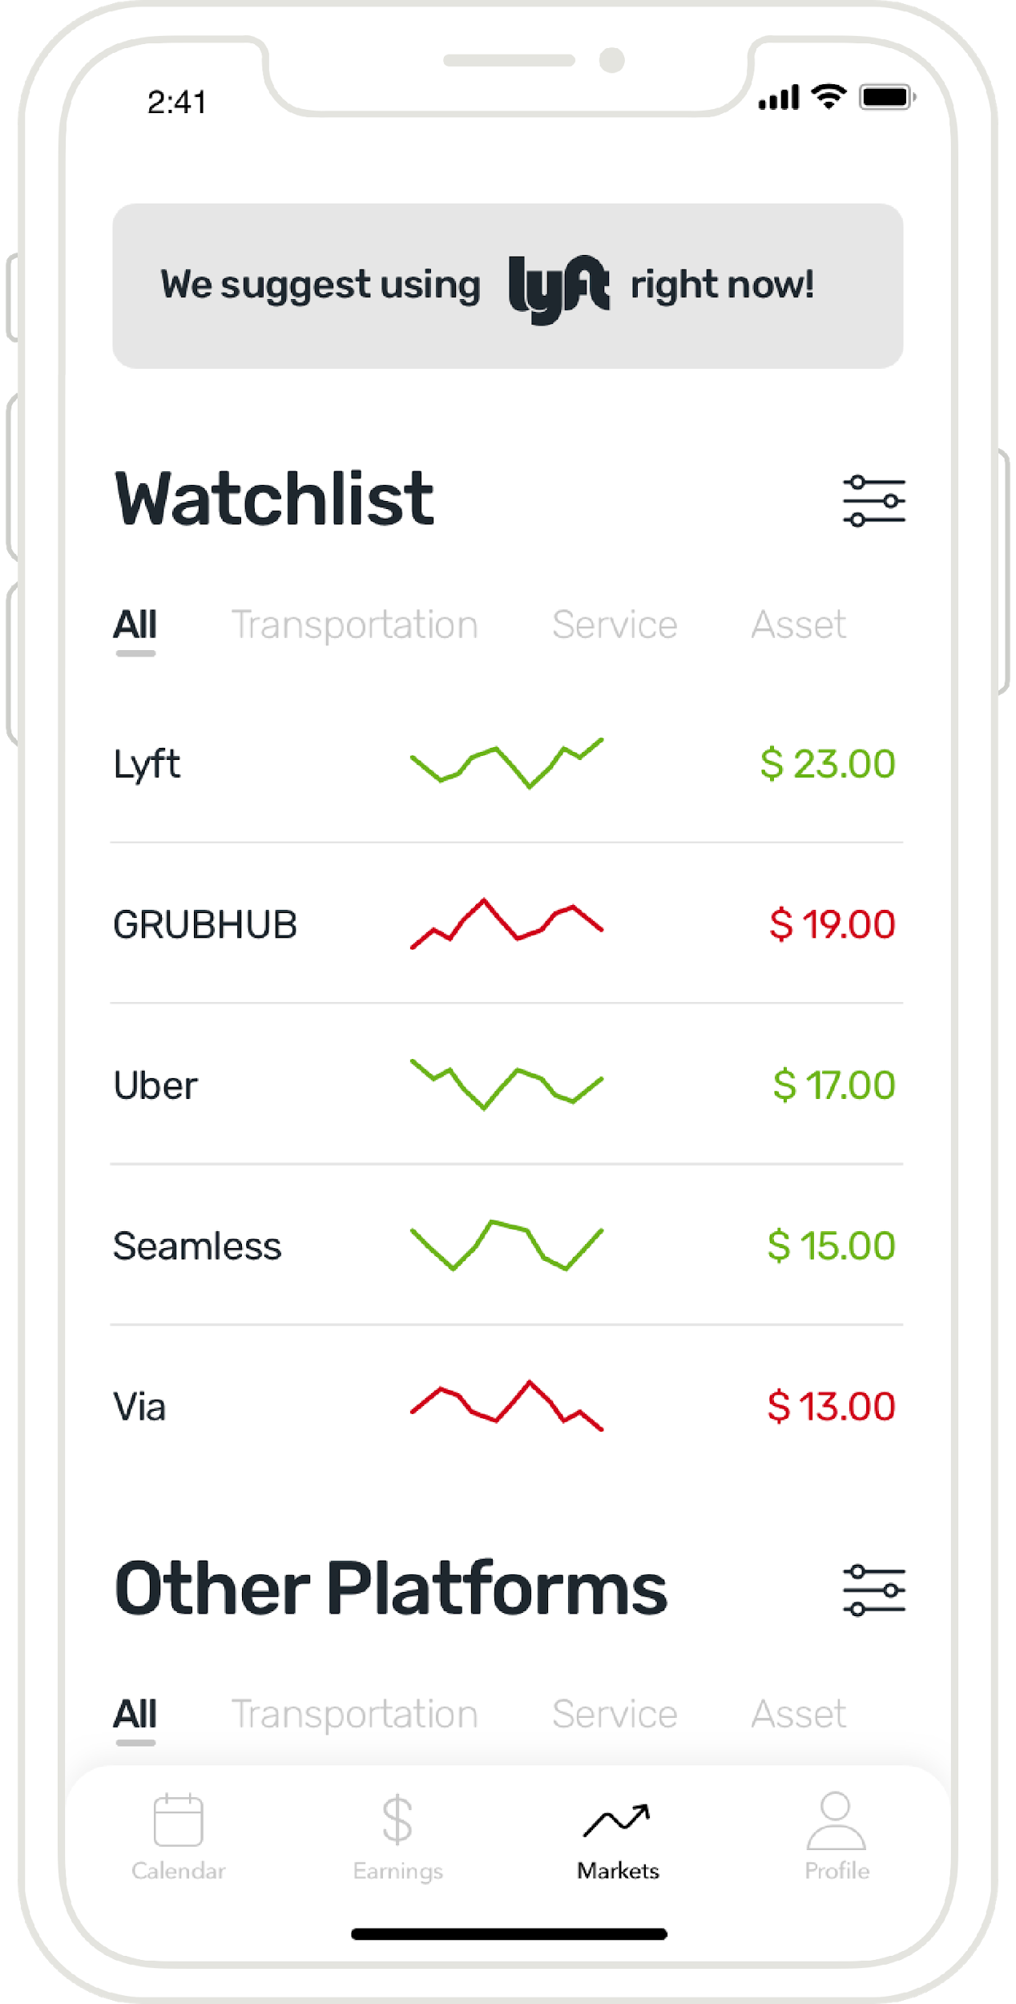
Notes:
User driven dashboard App for Gig Workers
GW can see which platform is most profitable at a certain point of time and at a specific location
Our goal is to provide..
Gig workers with a dynamic and transparent mobile platform that enables them to monitor their markets, make smarter decisions and ultimately

Slide 13
Tech
Placeholder
Notes:
User driven dashboard App for Gig Workers
GW can see which platform is most profitable at a certain point of time and at a specific location
Our goal is to provide..
Gig workers with a dynamic and transparent mobile platform that enables them to monitor their markets, make smarter decisions and ultimately

Slide 14
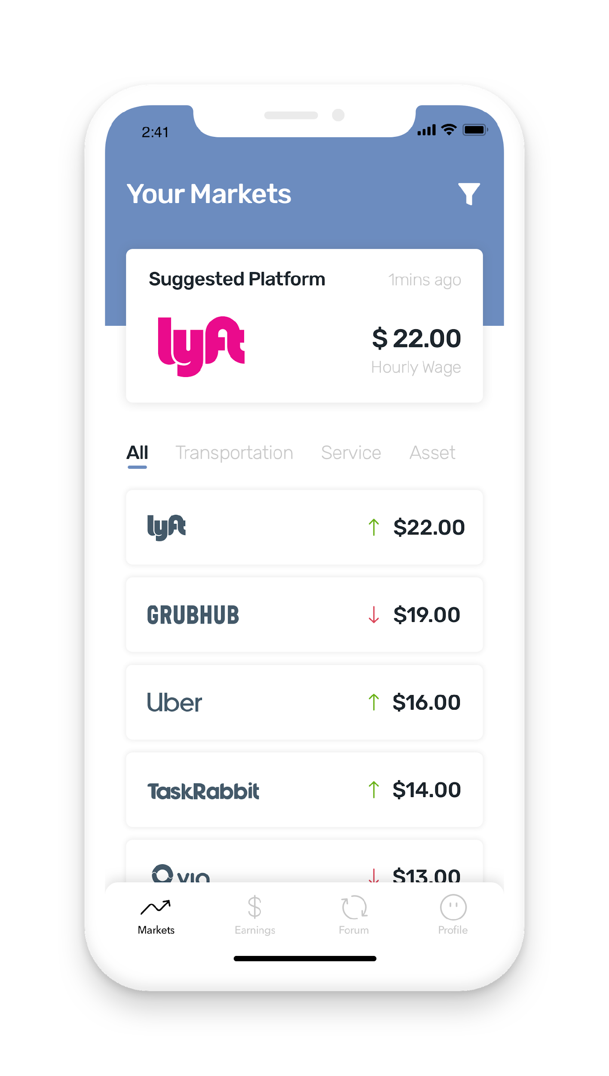
Gif
Placeholder
Notes:
User driven dashboard App for Gig Workers
GW can see which platform is most profitable at a certain point of time and at a specific location
Our goal is to provide..
Gig workers with a dynamic and transparent mobile platform that enables them to monitor their markets, make smarter decisions and ultimately

Slide 15
Next steps
Placeholder
Notes:
User driven dashboard App for Gig Workers
GW can see which platform is most profitable at a certain point of time and at a specific location
Our goal is to provide..
Gig workers with a dynamic and transparent mobile platform that enables them to monitor their markets, make smarter decisions and ultimately

Slide 16
Hunaid
MBA
Mechi
LLM
Max
Design
Willy
ORIE
Omesh
CM
Thank you!

Slide 17
How might we improve the lives of gig workers so that they are financially healthy and more resilient to financial shocks?
Bill & Melinda Gates Foundation

Slide 18
Appendix

Slide 19
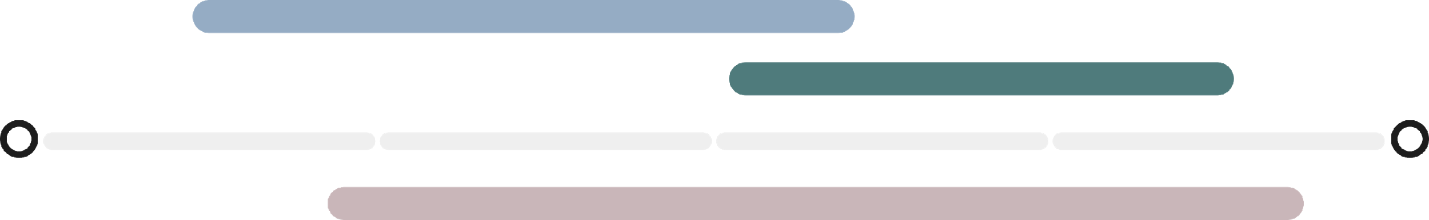
Sprint 2
Sprint 3
4 weeks
2 weeks
3 weeks
1.5 weeks
Notes:
-

Slide 20
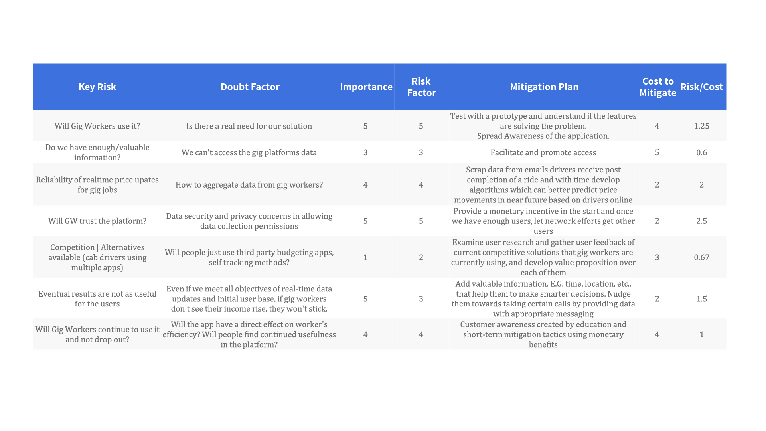

Slide 21
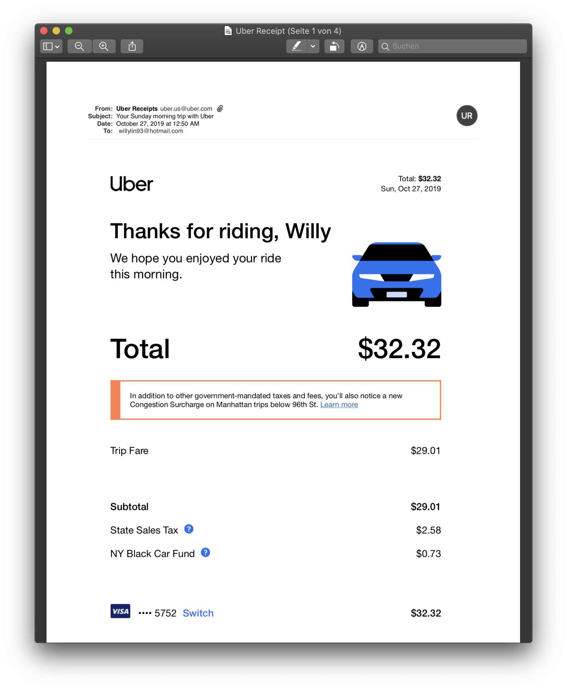
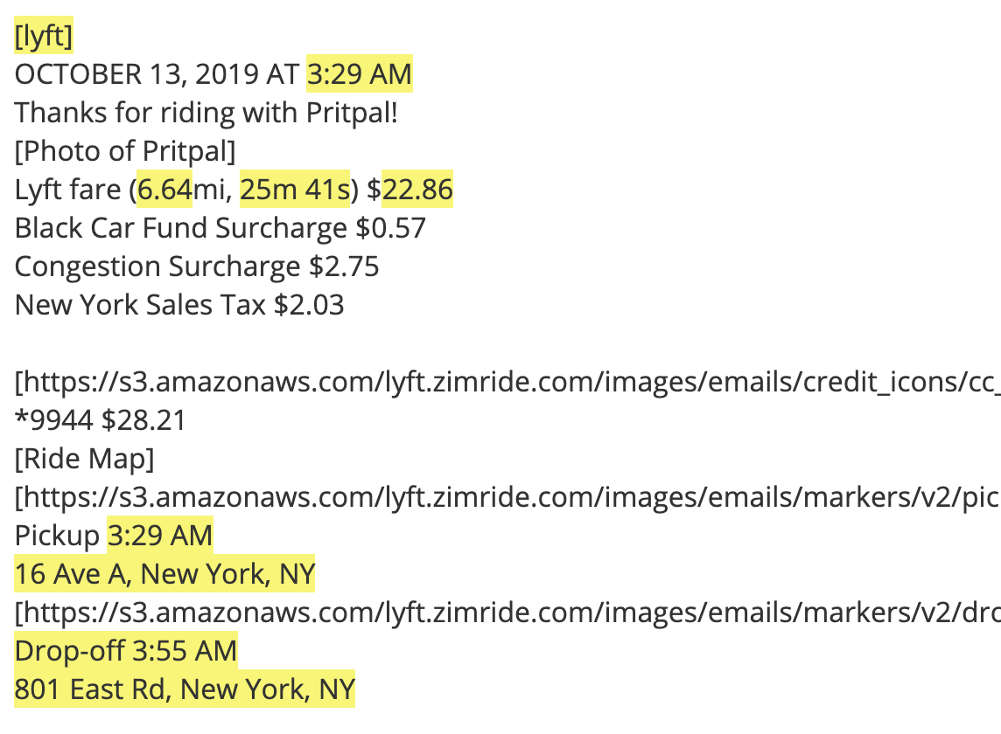
Experiment 1
Email Parser
Working on it
Notes:
Pilot running for quite some time

Slide 22
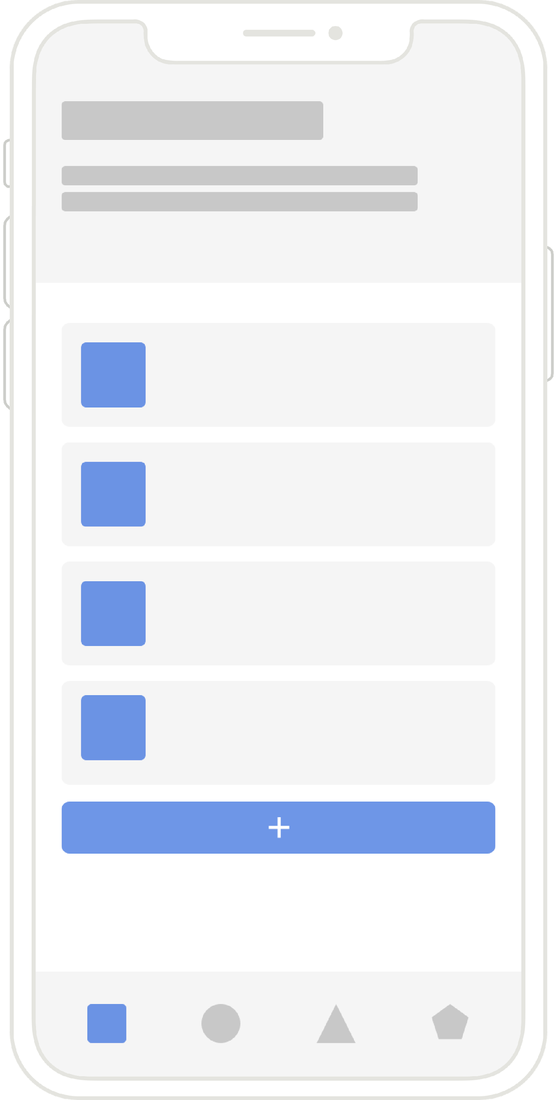
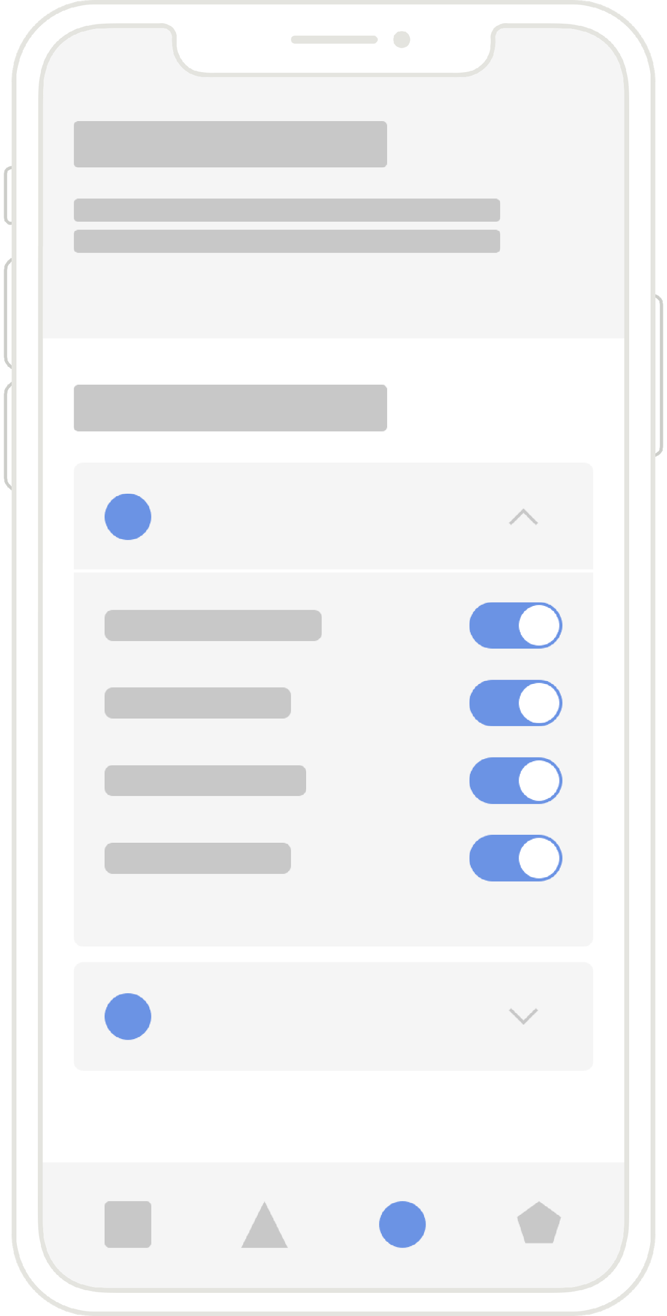
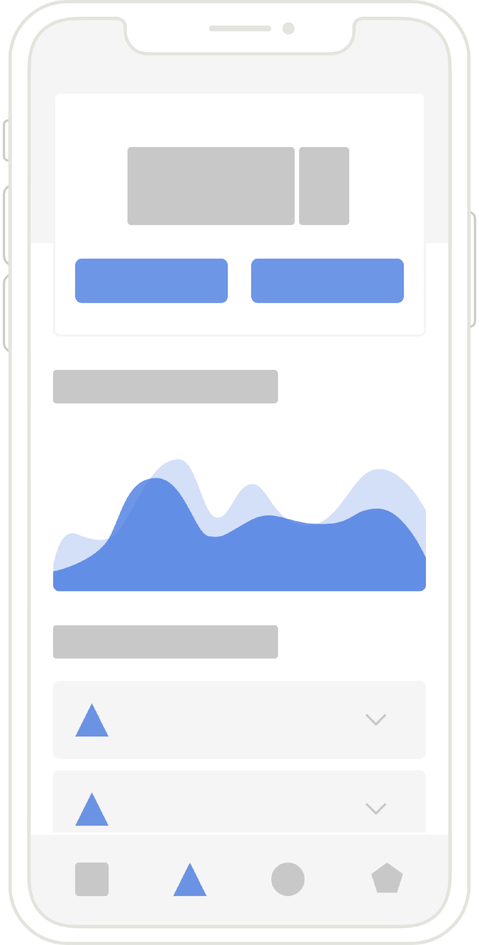
Experiment 2
Prototyping
Working on it

Slide 23
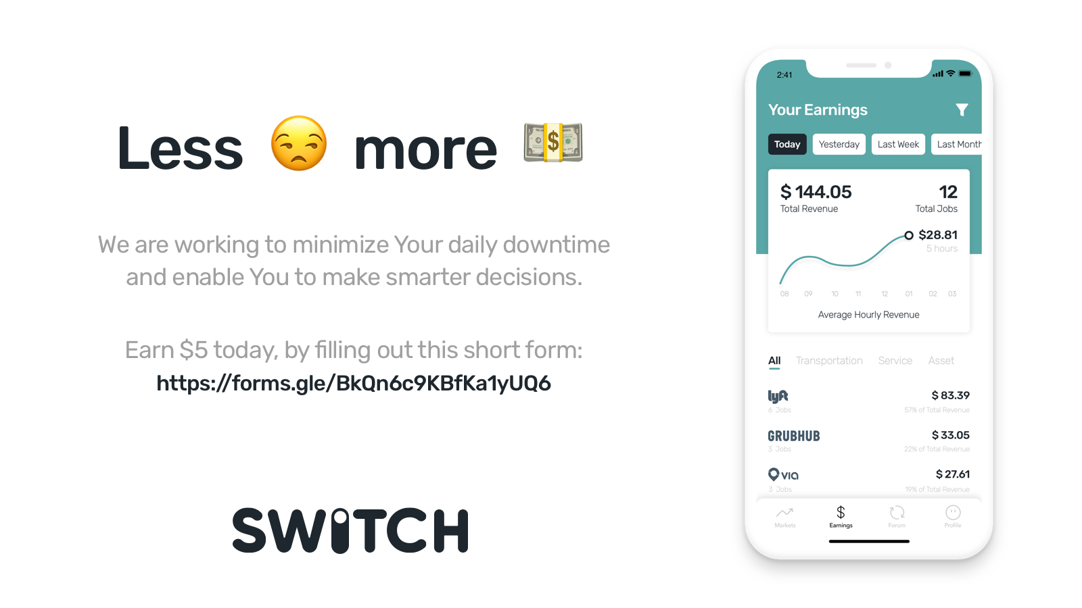

Slide 24
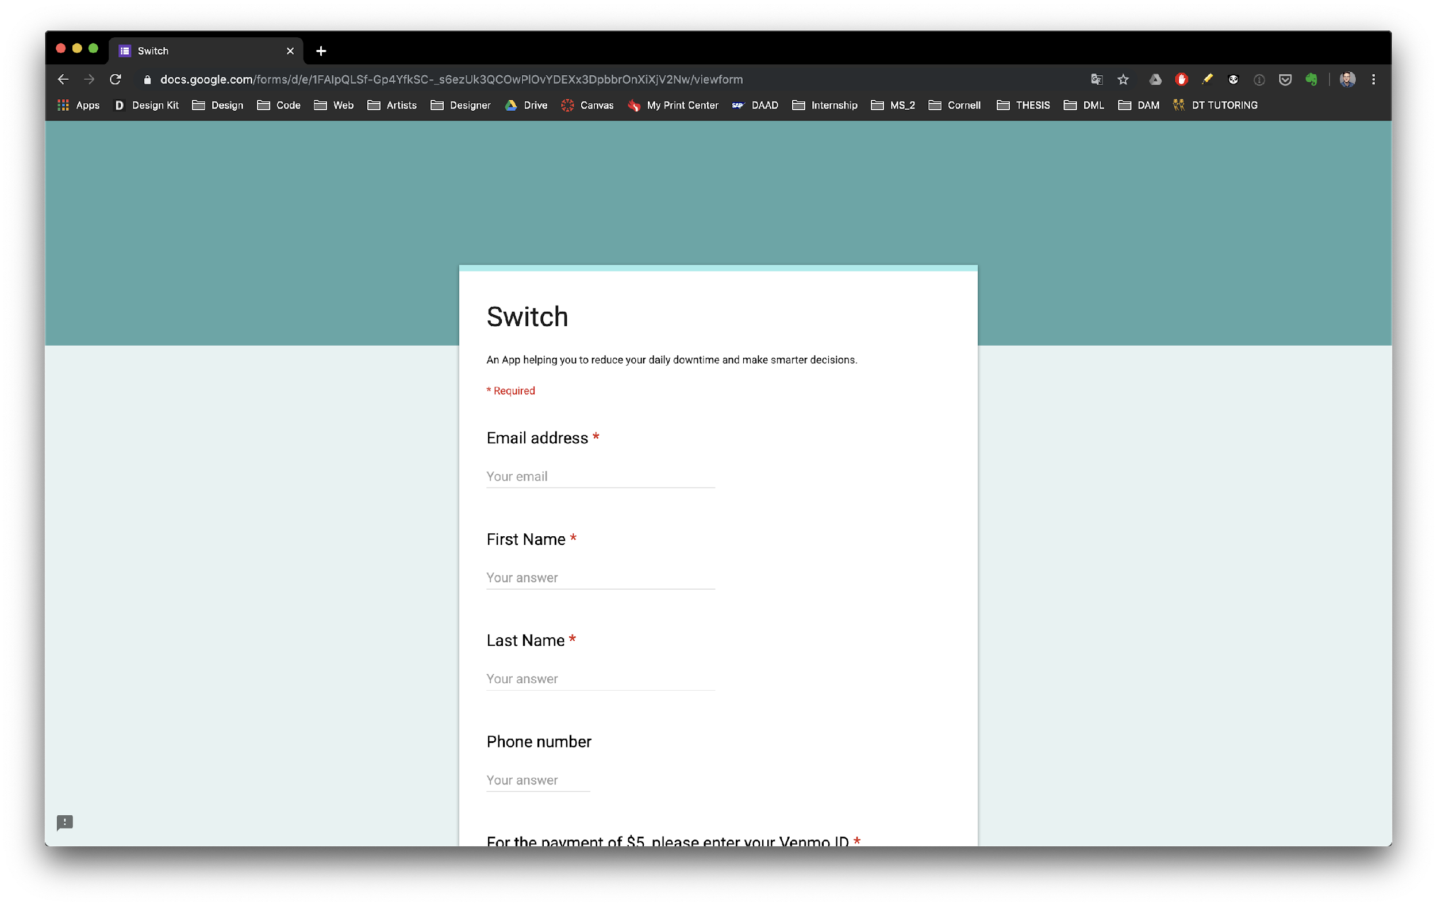

Slide 25
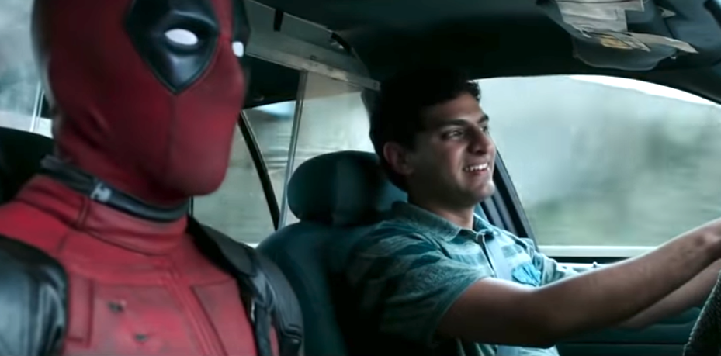
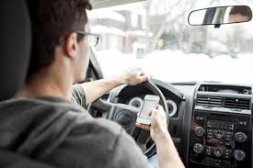
Experiment 3
Tag/Text Along
Not feasible
Notes:
Equivalent Experiment following the Wizard of Oz prototyping technique

Slide 26
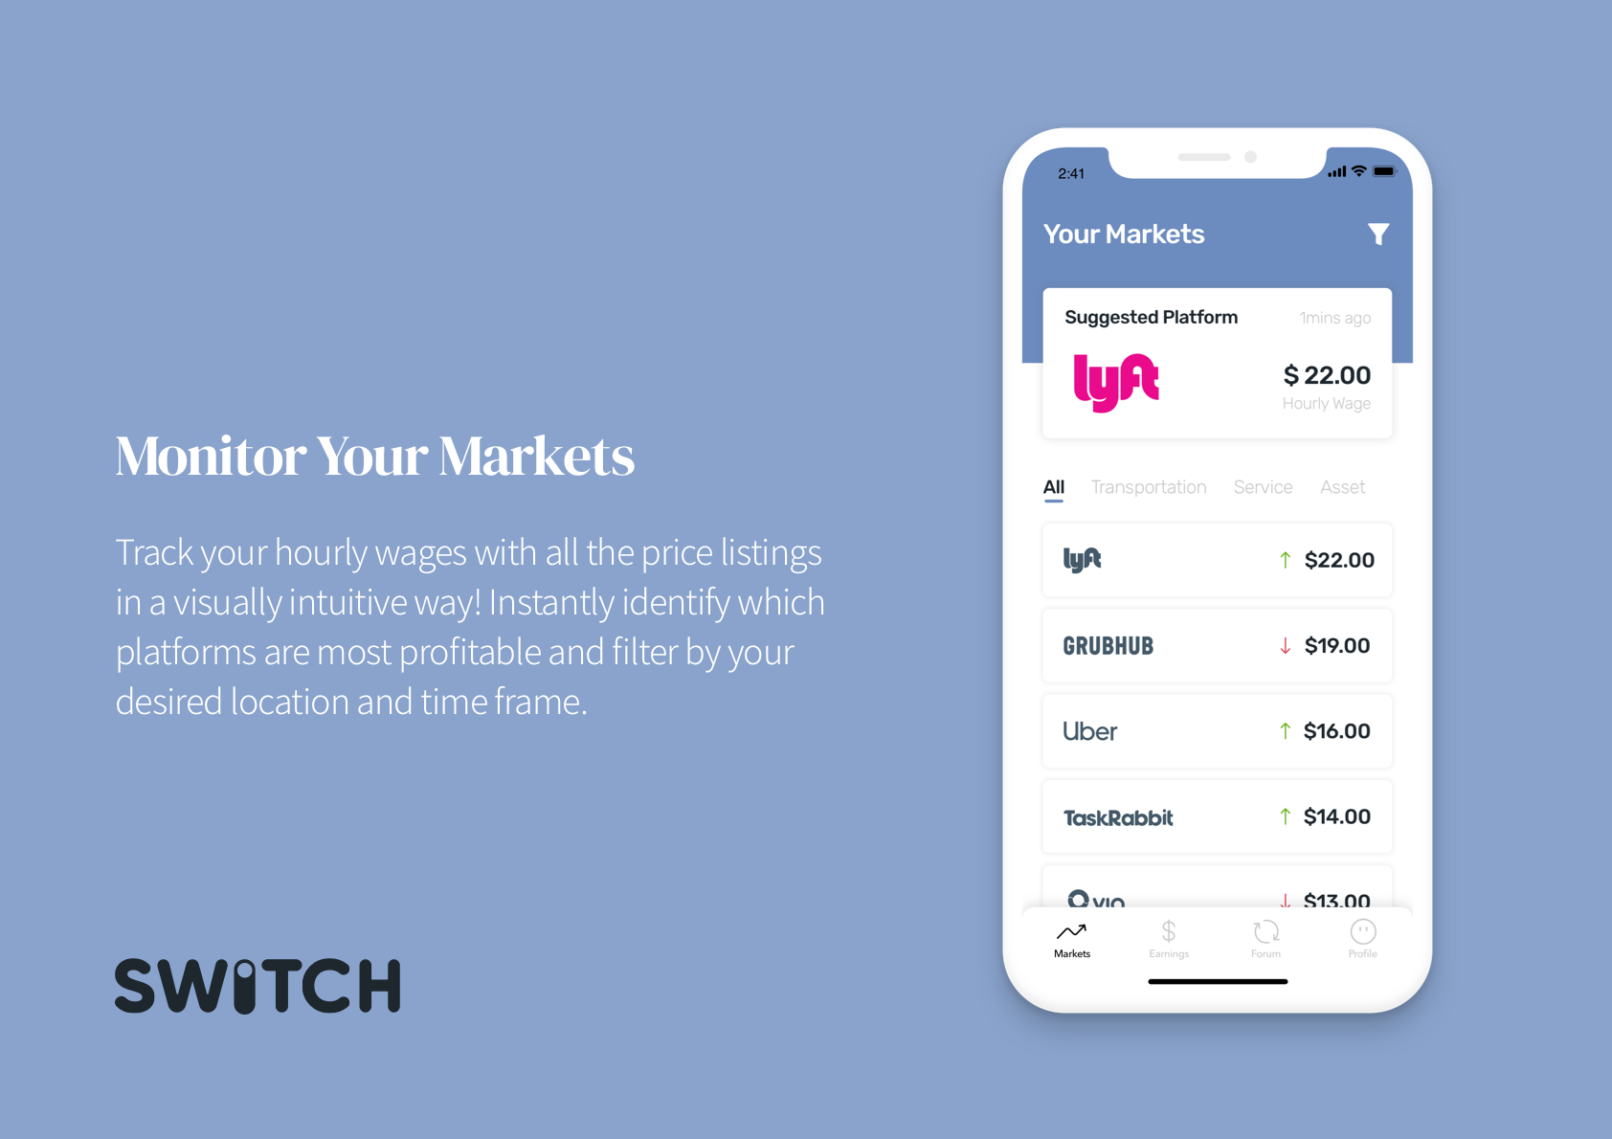
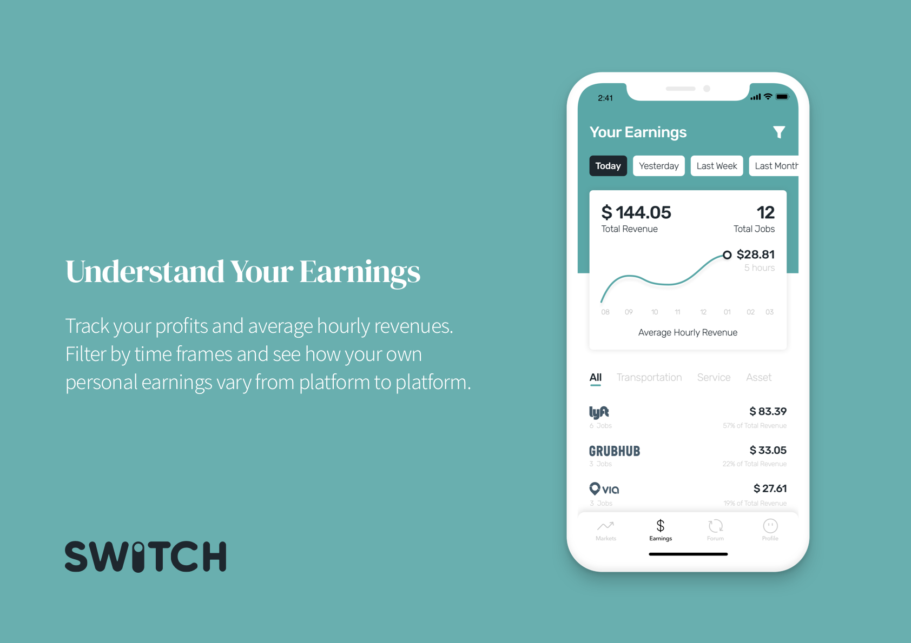
Experiment 3
Tag/Text Along
Notes:
Equivalent Experiment following the Wizard of Oz prototyping technique

Slide 27
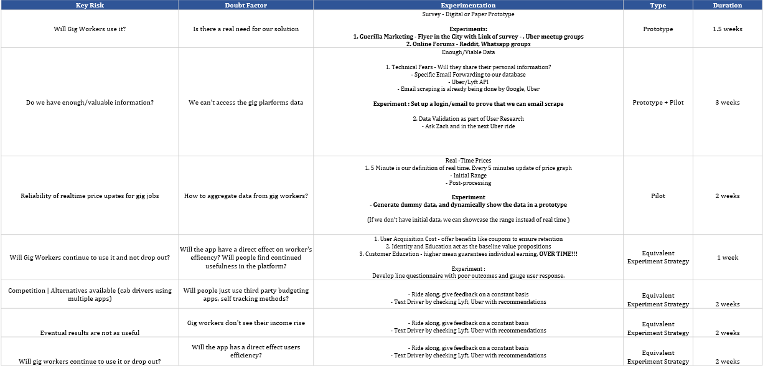

Slide 28
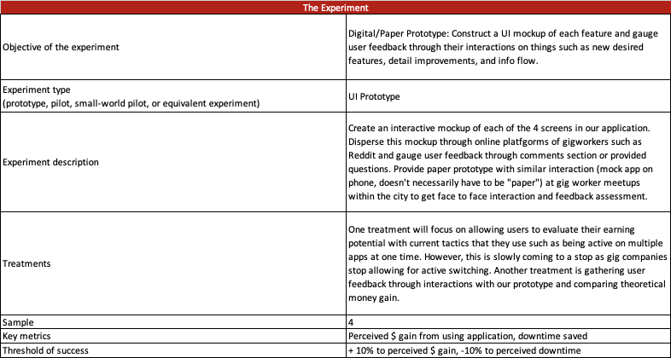

Slide 29


Slide 30
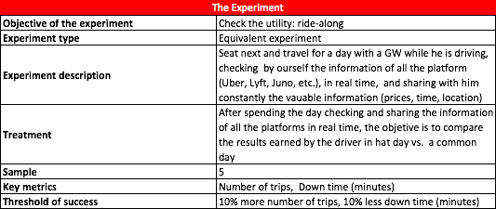

Slide 31


Slide 32
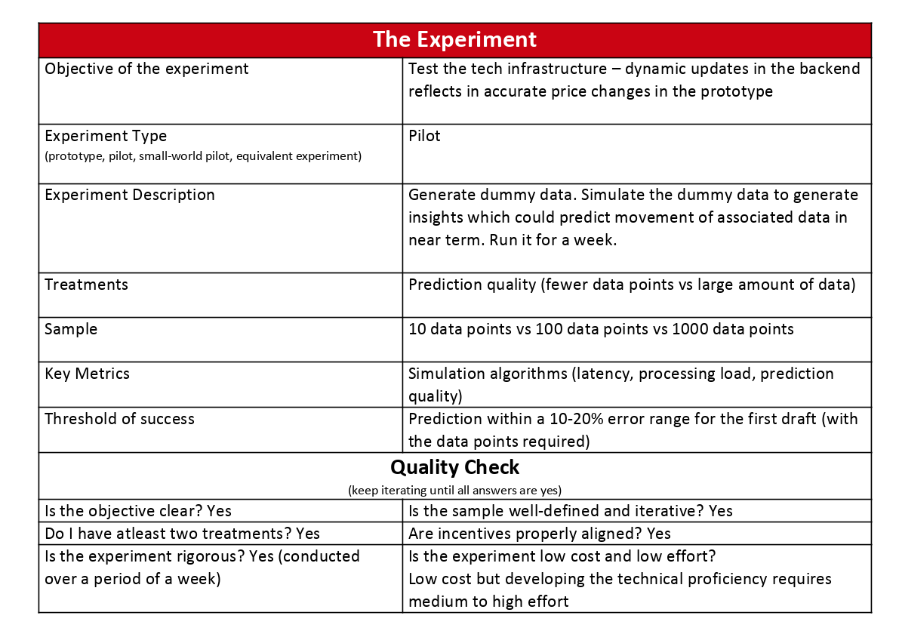

Slide 33
